Slide 1
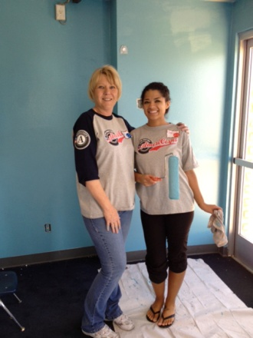
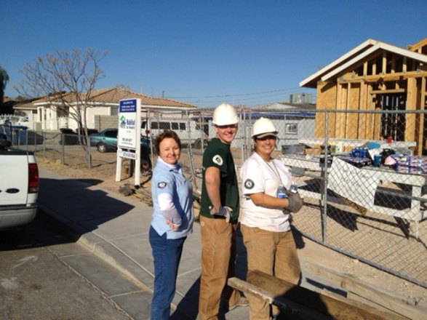
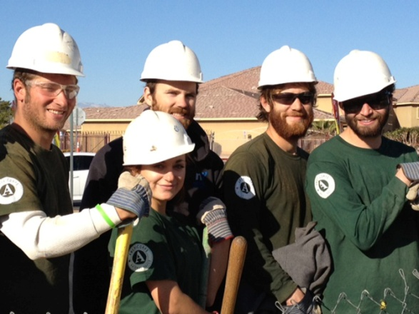
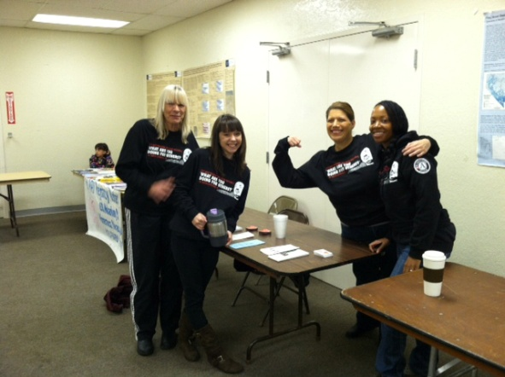
National Service in Nevada: Determining how your organization can fit
A presentation for organizations considering getting involved with AmeriCorps
Notes:
Laura
*PRESS —RECORD*
Welcome. Thank you for joining us for the National Service in Nevada: Understanding how your organization might fit presentation. Nevada Volunteers and the CNCS State Office of the Corporation for National and Community Services has joined forces to present this information. We did this because understanding the different types of National Service, distinctions in terms of what your organization will be required to do in relation to both and how both programs can be utilized is often confusing.
I am Laura Dickey the Director of AmeriCorps for Nevada Volunteers the Nevada Commission on service, which I will tell you more about later during the presentation. Co-presenting is Matt Johnson, State Director from the CNCS office.
One of the challenges local organizations have had in the past is determining if they are a good fit for an AmeriCorps grant. This presentation is an opportunity to cover some general AmeriCorps information that programs should know and consider before applying for either and AmeriCorps* State grant or for an AmeriCorps*VISTA Program.

Slide 2
This training
Will…
Will not…
Tell you about Nevada Volunteers and the Corporation for National and Community Service (CNCS)
Demystify AmeriCorps programs
Give you information about how your organization can apply for AmeriCorps resources
Give additional resources
Tell you how to become an AmeriCorps member
Ensure you are awarded an AmeriCorps or any other CNCS grant
Notes:
Laura
However, what this presentation will do is introduce you to national service programs in Nevada.
Outline what AmeriCorps programs and members can do (and some of what they cannot do) and talk about some of the requirements your organizations would need to meet in order to apply. Again, in depth instructions and requirements will be covered in the mandatory webinar in April. This webinar is meant to provide an introduction or food for thought.
It will not address how to apply to be an AmeriCorps member or give you an “in” for funding.
We are also not covering the application instructions as that will be covered in-depth webinars which will be highlighted elsewhere in this presentation.

Slide 3
National Direct
STATE OFFICE
Volunteer Initiative
National Civilian Community Corps
2016-17 Nevada AmeriCorps programs
Great Basin Institute-Nevada Conservation Corps
Nevada Outdoor School AmeriCorps Program
Nevada Department of Veterans Services
Nevada Statewide Coalition Partnership AmeriCorps Program
Truckee Meadows Parks Foundation
Urban Roots Garden Classrooms
City of Las Vegas
Notes:
Matt
This organizational chart is meant to provide you with an overview of the structure of National Service in Nevada. Note in the logos the three stars representing our three programs (AmeriCorps State and National, AmeriCorps Vista, AmeriCorps NCCC)
The three stripes represent citizenship, service, and responsibility.
CNCS is a federal agency which through public and private partnership engages more than 5 million Americans to serve in Senior Corps. AmeriCorps, and leads Presidents Obama’s national call to service initiative, United we Serve. Each year more than 1.5 million individuals help meet local needs through a wide array of services and each year through national service members more than 3.4 million volunteers are mobilized.
Laura
I will be address the three main programs in-depth in future slides, but wanted to draw your attention to the 2016-2017 Nevada –AmeriCorps STATE Programs, AmeriCorps state funding the the NOFO funding that Nevada Volunteers has released and which is currently open for application. 308 members serving at 64 host sites across Nevada.

Slide 4
Was created in 1993 through the signing of the National and Community Service Trust Act which expanded opportunities for Americans to serve their communities through national service
Engages millions of Americans of all ages and backgrounds in service through AmeriCorps, AmeriCorps*VISTA, and Senior Corps
In 2009 the Corporation was reauthorized through the signing of the Edward M. Kennedy Serve America Act
For more information on CNCS and the history of National Service please visit-
http://www.nationalservice.gov/about/role_impact/history_timeline.asp
Notes:
Matt
This federal agency which through public and private partnership engages more than five million Americans in service through Senior Corps, AmeriCorps, and Learn and Serve America, and leads President Obama's national call to service initiative, United We Serve.
Each year, more than 1.5 million individuals of all ages and backgrounds help meet local needs through a wide array of service opportunities.

Slide 5
Nevada Volunteers (a nonprofit 501 (c)3) is the Governor’s Commission on Service charged with awarding and administering the AmeriCorps*State funds throughout Nevada and is the state’s resource for volunteer service information. Through a competitive process, Nevada Volunteers funds high quality programs that:
develop an ethic of service
strengthen the capacity of communities to address unmet needs
demonstrate impact on communities
Nevada Volunteers mission is to enhance volunteerism and service through our AmeriCorps programs and our volunteer initiative.
Notes:
Laura
Nevada Volunteers, known previously as the Nevada Commission for National and Community Service, serves as the Governor’s commission to administer AmeriCorps programs throughout Nevada and as the state’s information and resource center for volunteer and service efforts.
building a collaborative statewide infrastructure that supports already-existing volunteer efforts across the state; increases and improves volunteer opportunities; and improves volunteer management and retention
We invite you and your organization to get involved by posting your volunteer opportunities through out volunteer match website or through sharing your information with us via Facebook or twitter. Each day we release a volunteer opportunity through our Facebook account. We strive to not only help organizations promote their volunteer opportunities, but help tell the story of the impact of volunteering on Nevada and provide training and resources to help volunteer managers build quality volunteer programs

Slide 6
CNCS State OFFICE
The CNCS Nevada State Office is staffed by federal employees who conduct public outreach and program support for the agency. These staff members are directly responsible for developing grants and projects, and for overseeing all Senior Corps and AmeriCorps VISTA projects within their states.
Notes:
Matt

Slide 7
National Civilian Community Corps
The mission of NCCC is to strengthen communities and develop leaders through team-based national and community service.
NCCC is a full-time, team-based residential service program for individuals ages 18-24.
Project sponsors include national, community and faith-based nonprofits; municipal and state governments; federal agencies and programs; city, state and national parks; Native American communities; and schools.
Notes:
Matt

Slide 8
National Civilian Community Corps
Natural and Other Disasters
Infrastructure Improvement
Environmental Stewardship and Conservation
Energy Conservation
Urban and Rural Development
Since 2000, NCCC teams have:
Assisted nearly 7.5m people in disaster areas
Recruited or coordinated 659,233 volunteers
Constructed or restored 8,738 miles of trail
Removed 21,532 tons of debris or vegetation
Notes:
Matt

Slide 9
2017-2018 CNCS Focus Areas
Disaster Services: Improving community resiliency through disaster preparation, response, recovery, and mitigation.
Economic Opportunity: Increasing economic opportunities for communities, specifically opportunity youth (see NOFO Glossary), both as the population served and as AmeriCorps members.
Education: Improving student academic performance including STEM.
Environmental Stewardship: 21st Century Service Corps (see NOFO Glossary).
Healthy Futures: Reducing and/or Preventing Prescription Drug and Opioid Use
Veterans and Military Families: Positively impacting the quality of life of veterans and improving military family strength.
Governor and Mayor Initiatives (see NOFO Glossary).
Programming that supports My Brother’s Keeper (see NOFO Glossary).
Multi-focus intermediaries that demonstrate measureable impact and primarily serve communities with limited resources and organizational infrastructure. i.e. rural and other underserved communities (see NOFO Glossary).
Safer communities
Evidence-Based Intervention Planning Grants
Encore Programs
Notes:
Laura
These 12 priority areas are what grantees will select National Performance Measures for their programs. IN depth information on these areas are in the actual NOFO and on the AmeriCorps website.
If you are considering applying you should spend time in advance of your application reviewing the performance measures under each areas, looking at the Logic model/theory to create your performance measures. There is a link at the end of this presentation to assist you in doing so.
BREAK FOR QUESTIONS

Slide 10
2017-2018 Nevada Volunteers Focus Areas
Programs focused on serving and/or engaging Veterans and Military families.
Programs focused on education including those that will improve school readiness, improve educational outcomes, and prepare students for success in post-secondary institutions.
Programs that have a primary member duty of direct service and capacity building activities in the area of volunteer recruitment, management and effective volunteer practices and apply an intermediary program design.
Notes:
Laura
These 2 priority areas are what grantees will select National Performance Measures for their programs. IN depth information on these areas are in the actual NOFO and on the AmeriCorps website.
If you are considering applying you should spend time in advance of your application reviewing the performance measures under each areas, looking at the Logic model/theory to create your performance measures. There is a link at the end of this presentation to assist you in doing so.
BREAK FOR QUESTIONS

Slide 11
Eligibility for an AmeriCorps Grant
Non-Profit Organizations
Community/Regional/Statewide
Faith based
Secular
Government
State/County/Local
Education
Districts
Private
Higher Education
Indian Tribes
Notes:
Laura
Nevada Volunteers is specifically interested in organizations who wish to serve as intermediaries.

Slide 12
Benefits of an AmeriCorps grant
Expands the capacity of an organization to meet identified critical community needs.
Provides funds to support program administration (AmeriCorps State only), access to training and technical assistance resources, and entrance into a national network of organizations.
Allows organizations to recruit individuals from the community to serve as AmeriCorps members.
AmeriCorps members gain skills, experience and an End of Service Award to be used to further their education or repay student loans.
Members and volunteers gain a better understanding of community needs/challenges and how to solve them.
Notes:
Laura
It is very important for an organization applying for an AmeriCorps grant to understand the dual goals of impacting the community and supporting AmeriCorps members to develop and build skills to support future opportunities. A large focus of an AmeriCorps program is support of its members.
But to highlight some key benefits and expectations of an AmeriCorps grant.
EXPANDS capacity

Slide 13
What can AmeriCorps Programs do?
AmeriCorps State
AmeriCorps VISTA
AmeriCorps State Programs address diverse community needs in the CNCS focus areas through direct services that:
have a demonstrable impact;
result in a specific, identifiable benefit that would not be provided with existing funds, volunteers and that does not duplicate the routine function of workers or displace paid employees;
And,
expand economic opportunity through the development of AmeriCorps members, helping them acquire the skills, education and training
All AmeriCorps VISTA Programs have an anti-poverty focus. VISTA Members build capacity for the organizations the serve rather than providing direct services by:
Developing infrastructure;
Fundraising;
Developing volunteer programs;
Developing partnerships;
Working towards sustainable solutions.
Notes:
Laura 1st then Matt
This list of different options is not all inclusive. Visit the AmeriCorps.gov website to read about what other organizations and commissions are doing with their AmeriCorps members
Examples of AmeriCorps State member activities include…
Improving graduation rates
Reducing youth obesity rates
Increasing number of individuals receiving their GED
Improving school performance
Reducing homelessness by assisting individuals/families with securing sage and affordable housing
Increasing the number of public awareness/education programs around a particular topic (illiteracy, health, etc.)
Increasing the number of after-school slots for youth participants.
There are very specific limitations on the use of AmeriCorps State members duties-prohibited and unallowable activities.

Slide 14
How are AmeriCorps*State and AmeriCorps*VISTA different?
All AmeriCorps Members
Differences for AC State and VISTA
Enroll for a specific term of service
Are not volunteers or employees
Receive an End of Service Award
Receive a living allowance, health insurance, child care assistance
Are subject to criminal history checks.
Must be:
U.S. Citizen, U.S. Nationals, or Lawful Permanent Residents of the United States
VISTA’s serve 365 day terms
AC State members serve 300, 450, 675, 900, or 1700 hour terms.
VISTA’s can choose a cash award or a Segal AmeriCorps Education Award.
AC State members can only choose the Education Award.
AC State members must be providing direct services, AC VISTA members should be focused on capacity building
Notes:
Matt
National Service members which receive a modest living allowance and education award for a significant amount of time and effort serving.
Highlight that members are not employees and they must go through a criminal background check as outlined through AmeriCorps rules and provisions.

Slide 15
What are my responsibilities if I get an AmeriCorps program?
AmeriCorps VISTA
AmeriCorps State
All of the AmeriCorps VISTA responsibilities AND
Have financial management systems (i.e. accounting practices and procedures, internal controls, audit trails, and cost allocation procedures.)
Maintain records, audits, and participant information in accordance with AmeriCorps Regulations, Provisions and the Serve America Act
Ensure that your activities, including those of host sites, will be conducted, and facilities operated, in compliance with the applicable civil rights statutes and their implementing regulations.
Recruit quality applicants;
Develop orientation and training plans;
Provide a well-defined position description;
Track and report progress towards well-defined goals;
Provide supervision and support to members
Notes:
Matt 1st then Laura
This list is not all inclusive. What is important to note is there are very REAL and intensive commitments when one applies for an AmeriCorps Program . You will see there are tangible differences based off of if you apply for an AmeriCorps state program, which provides funding to your organization, or AmeriCorps Vista which provides human capital.
BREAK FOR QUESTIONS

Slide 16
AmeriCorps State Grants… 2017-2018 Nevada AmeriCorps State grant opportunities
Operational Grant - Sound program design and implementation strategy identified; clearly articulated member responsibilities, activities, training, supervision, evaluation, organizational history and capacity, sustainability plans and fund management.
Fixed-Amount - Grantees will receive an award for a specific amount of MSY; No match required and no approved budget. This opportunity is only available to organizations with a proven track record in operating an AmeriCorps program.
Evidence-Based Intervention Planning Grant – Develop new national models that seek to integrate members in innovative ways into evidence-based interventions.
Planning Grant – Planning grants do NOT provide AmeriCorps members. Planning grants provide initial funding to support current staff or hire additional staff who can plan the proposed AmeriCorps program, negotiate collaborations with partners, develop meaningful performance measures, and develop systems for successful implementation of the AmeriCorps operational grant application that is submitted the following year.
Key Considerations
AmeriCorps State grants provide partial funding, solely for program expenses in an amount directly tied to the specific number of members requested and requires the organization to provide a cash or in-kind match to support the project.
Notes:
Laura
And the match increases each year with specific amounts. For a first time applicant the match requirement is 24%
Please note if you are looking for 1 or 2 members then you will want to consider a host site agreement or an AmeriCorps VISTA rather than this AmeriCorps*State funding as Nevada Volunteers requires a minimum of 10 MSY.

Slide 17
AmeriCorps State Grants…
What amount can I request?
The size of an AmeriCorps grant is directly related to the number of Member Service Years (MSY) an applicant requests. Nevada requires program design to support at least 10 members with a full time program director. Except for the priority areas listed below, organizations unable to support 10 MSY should consider applying to become a host site with an existing grantee.
We will consider programs proposing to sponsor fewer than 10 MSY if the proposal clearly targets rural communities, engaging and/or serving Veterans, or food insecurity/sustainability.
1 MSY is equivalent to 1 Full Time member (1700 hours).
The number and kind of slot configuration will determine the number of MSY requested by the program i.e. 10FT, 10 HT, 12 QT = 32 slots and 18.18 MSY.
The application instructions help you calculate the number of MSY. Cost per MSY is a competitive factor during grant review.
Maximum Cost per MSY for 2017 $13,830
Notes:
Laura
Talk about host site option and what that means-NOT a part of this NOFO, but working directly with Nevada Volunteers Sub grantees. There are fees to hosting an AmeriCorps member and those vary by sub grantee and type of member term (FT, PT, etc). Host site fees range from $6,000 per MSY to $9,000 per MSY. Part-Time host site fees tend to run around $3,000.

Slide 18
Required Match
 | Year 1 | Year 2 | Year 3 | Year 4 | Year 5 | Year 6 | Year 7 | Year 8 | Year 9 | Year 10
Minimum overall Share | 24% | 24% | 24% | 26% | 30% | 34% | 38% | 42% | 46% | 50%
Notes:
Laura

Slide 19
AmeriCorps State Selection Criteria
Program Design (50%): Problem/Need, Theory of Change and Logic Model, Evidence Base, NOFO Priority, Member Training, Member Supervision, Member Experience, AmeriCorps Identification, Volunteer generation.
Link: Need Intervention Member Activities Anticipated outcomes
Organizational capability (25%): Sound organizational structure, success in securing community support, compliance and accountability.
Cost Effectiveness and Budget Adequacy (25%): Budget is clear, reasonable, cost-effective and in alignment with program narrative not exceeding maximum MSY.
New Grantees: evidence of ability to meet match, identified need and intervention, demonstrated ability to manage an AmeriCorps program through the Readiness Self Assessment.
Intermediaries that provide support to organizations with limited organizational capacity are encouraged to apply.
Notes:
Laura
Program Design
Community Need—Convincingly links the need, the evidence based intervention that will be carried out by AmeriCorps members and community volunteers, the ways AmeriCorps member are well-suited to deliver the intervention and the anticipated outcomes (performance measures).
Nevada Volunteers applicants are required to meet National Performance measures and program specific performance measures for every member activity.
Ethic of Services--Describes program components that enable AmeriCorps members to have a powerful service experience that produces increased community impact and lead to continued civic participation and connectivity with other AmeriCorps participants.

Slide 20
2017-2018 AmeriCorps State Grant Application ‘Formula’ Timeline
November 10, 2016 – Pre-Application Deadline: Applicants must submit a pre-application for this competition regardless of whether they will be applying for the competitive or formula funding consideration, unless they are a competitive continuation applicant.
December 2, 2016 – Applicants notified if they will be on the Competitive or Formula application timeline.
December 20, 2016 – Competitive Application Deadline: A first draft of the full application will be due in eGrants by 5 p.m. PST by December 20, 2016. Final Applications are due in eGrants and required documents are due via email to grants@nevadavolunteers.org by 5 p.m. PST Wednesday, January 20, 2017.
February 10, 2017 – Formula Application Deadline: Applications are due in eGrants and additionally required documents are due via email to egrants@nevadavolunteers.org by 5 p.m. PST Friday, February 20, 2017.
May 15, 2017 – Application Notification: Successful competitive applicants will be notified no later than Monday, May 15, 2017.
June 10, 2017 – Application Notification: Successful formula applicants will be notified no later than June 10, 2017.
Notes:
Laura
Links in NOFO to register for the trainings. Note deadlines.
Utilize the t/ta time period to submit questions.
BREAK FOR QUESTIONS?

Slide 21
2017-2018 AmeriCorps State Grant Application Training and Technical Assistance Opportunities
October 6, 2016, 10:00 to 11:30 a.m. WEBINAR ~ Understanding AmeriCorps and Determining Organizational Fit
October 13, 2016 , 10:00 to 11:30 a.m. WEBINAR ~ Program Design and Logic Models
October 14, 2016, 9:00 to 11:00 a.m. Reno In-person Meeting ~ Navigating National Service and determining the best resource for your organization United Way of Northern Nevada and the Sierra
October 20 , 2016, 10:00 a.m. to 11:30 a.m. WEBINAR ~ Understanding the NOFO Narrative and Performance Measures Requirements
October 26, 2016, 2:30 p.m. to 4:30 p.m. Las Vegas In-person Meeting ~ Navigating National Service and determining the best resource for your organization United Way of Southern Nevada
October 27, 2016, 10:00 a.m. to 11:30 a.m. WEBINAR ~ Understanding the AmeriCorps Budget and NOFO Requirements
All webinars are being recorded and posted to Nevada Volunteers website.
Notes:
Laura
Links in NOFO to register for the trainings. Note deadlines.
Utilize the t/ta time period to submit questions.
BREAK FOR QUESTIONS?

Slide 22
AmeriCorps*VISTA Grants
Human resource not $$$
No matching requirement but strict limitation on duties and goals
3-5 year resource only
No fewer than 2 members and rarely more than 5
Must submit a Concept Paper prior to application.
Notes:
Matt

Slide 23
CNCS State OFFICE – VISTA Grants
Applying for AmeriCorps* VISTA Grants
What to expect?
CNCS State will release request for concept papers in the next month
6 month application process
VISTAs starting date April 2017
TT & A webinars & outreach
Is your organization on the interest list?
Notes:
Matt

Slide 24
NCCC – Project Concept Form Deadlines
Teams Available
Round 1 (Nov 7 – Dec 21)
Round 2 (Jan 11 – Mar 17)
Round 3 (Mar 27 – May 16)
Round 4 (May 24 – July 12)
Project Concept Form Deadline
- July 1, 2016
- September 6, 2016
- December 5, 2016
- February 1, 2017
Notes:
Matt

Slide 25
Is AmeriCorps a fit for my organization?
AmeriCorps State
AmeriCorps VISTA
Does my organization address compelling needs in education, the environment, public safety, homeland security or other human needs?
Would this program support my organization’s mission and strategic plans?
What will be the change in the community as a result of the presence of AmeriCorps members?
Does my organization have the organizational, technological and fiscal capacity to handle a federal grant?
Does my proposal have an anti-poverty focus?
What will VISTA’s do to build capacity?
Can my organization provide a designated person to recruit and supervise VISTA Members?
Take VISTA 101
Notes:
Laura 1st then Matt
Assessing if your organization is ready for a federal grant like an AmeriCorps grant can be done through the readiness assessment. That form is on our website and is required of all new applicants. Be honest. It is tool to help organizations considering applying to assess their fit and it is a tool we consider in evaluating your capacity to manage federal funds.

Slide 26
Helpful links
AmeriCorps State
AmeriCorps VISTA
2017-2018 Notice of Funding Opportunity, Instructions, and Attachments
http://nevadavolunteers.org/americorps/americorps-funding/notice-of-funding-opportunities/
Link to eGrants
http://www.nationalservice.gov/egrants/
Link to Program start –up resources:
http://s3.amazonaws.com/resource_center_video/taag/program-start-up/index.html
Performance Measurement Resources
https://www.nationalserviceresources.gov/npm/ac#.VEkeK_ldW_A
VISTA 101
http://www.vistacampus.org/v101
201 VISTA Program Guidance
http://www.nationalservice.gov/programs/americorps/americorps-vista/sponsor-vista-projectVISTA Campus
VISTA Campus
http://www.vistacampus.gov/
Notes:
Laura and Matt

Slide 27
For more information
Nevada Volunteers, AmeriCorps*State
Laura J. Dickey
Director of AmeriCorps
775.825.1900
laura@nevadavolunteers.org
www.nevadavolunteers.org
CNCS State Office, Nevada, AmeriCorps*VISTA
Matt Johnson, State Program Director
775.784.7474
mjohnson@cns.gov
www.nationalservice.gov
National Civilian Community Corps
James Griffin
Assistant Program Director
AmeriCorps NCC/Pacific Region
916.640.0333 (office)
202.534.7034 (cell)
jgriffon@cns.gov
Tanya Gipson-Nahman
Deputy Region Director for Programming
AmeriCorps NCCC/Pacific Region
tgipson-nahman@cns.gov
Notes:
Laura and Matt

